Slide 1
FAKE NEWS DETECTION
A Machine Learning Project Presentation

Slide 2

Gourab Ghosh M.Sc. in Big Data Analytics Department of Computer Science Ramakrishna Mission Vivekananda Educational And Research Institute Belur Math, Howrah

Slide 3
CONTENT
SL. NO. | TOPICS | PAGE NO.
1 | Introduction | 4
2 | Objective | 5
3 | Dataset | 6-7
4 | Project Work | 8-11
5 | Results I | 12-15
6 | Results II | 16-19
7 | Conclusion | 20

Slide 4
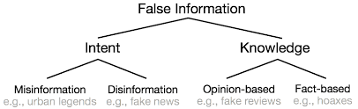
1. INTRODUCTION :
Machine Learning is the systematic study of algorithms and systems that improve their knowledge or performance with experience. Machine Learning focuses on the development of computer programs that can access data and use it to learn for themselves.
A type of Yellow Journalism, that present very little or no legitimate well-researched news while instead using eye-catching headlines for increase in sales is FAKE NEWS. Techniques may include exaggerations of news events, scandal-mongering, or sensationalism. Fake News encapsulates pieces of news that may be hoaxes and is generally spread through social and online media. These types of news may contain false or exaggerated claims, and may end up being virialized by algorithms.

Slide 5
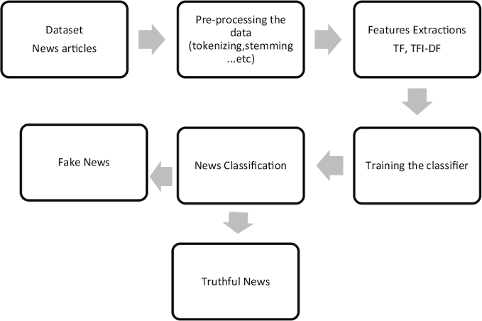
2. Objective :
In the age of social media where we continuously have different kind of news and opinions, it is indeed quite important to understand which one is true or false. In the world of Facebook, Twitter, Instagram, YouTube and many others where millions and millions of news circulate in seconds, it is required to keep track of which one is useful and which one is not.
In this Machine Learning Project, I have worked on to build a model in Python which can accurately detect whether a piece of news is Real or Fake.

Slide 6
3. DATASET :
The Dataset that I have used here for my Project is called “news.csv”. The dataset has a shape of 6335*4. The 1st column identifies the news, the second and third one is the title and text respectively and the fourth column has labels indicating whether the news is REAL or FAKE.
Table For Dataset Head
Unnamed: 0 | Title | Text | Label
8476 | You Can Smell Hillary’s Fear | Daniel Greenfield, a Shillman Journalism Fellow... | FAKE
10294 | Watch The Exact Moment Paul Ryan Committed Pol... | Google Pinterest Digg LinkedIn Reddit Stumbleu... | FAKE
3608 | Kerry to go to Paris in gesture of sympathy | U.S. Secretary of State John F. Kerry said Mon... | REAL
10142 | Bernie supporters on Twitter erupt in anger ag... | — Kaydee King (@KaydeeKing) November 9, 2016 T... | FAKE
875 | The Battle of New York: Why This Primary Matters | It's primary day in New York and front-runners... | REAL

Slide 7
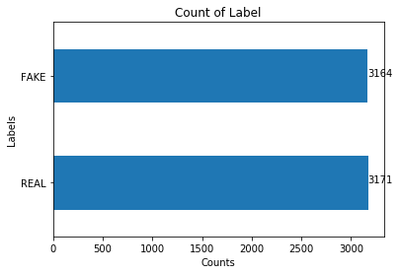
Table For Count Of Labels
Plot For Count Of Labels
LABELS | COUNTS
REAL | 3171
FAKE | 3164

Slide 8
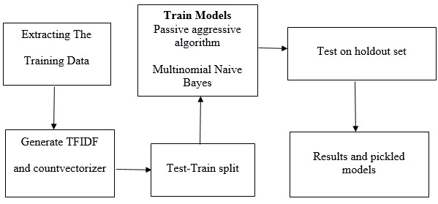
4. PROJECT WORK :
This Python Project of Detecting fake news deals with “FAKE" and “REAL" news. Using sklearn, I have built a TfidfVectorizer and CountVectorizer on the dataset. Then, I have initialized a PassiveAggressive Classifier and MultinomialNB Classifier and have tested the dataset for all models. In the end, the Accuracy Score tells us how good the model is fitted and the Confusion Matrix depicts the summary. I have also plotted the ROC Curve and calculate AUC Score to tell which classifier performs best.

Slide 9
TF (TERM FREQUENCY) :
The number of times a word appears in a document is its Term Frequency. It gives us the no. of occurrence or frequency of a given word in a document under study. A higher value means a term appears more often than others, and so, the document is a good match when the term is part of the search terms. If the word has higher no. of frequency in a document, then we can say that the document works as a support of word.
IDF (INVERSE DOCUMENT FREQUENCY) :
Words that occur many times in a document, but also occur many times in many others as well, may be irrelevant. IDF is a measure of how significant a term is in the entire corpus. IDF works as a measure of significance for a given word in the document.
The TfidfVectorizer converts a collection of raw documents into a matrix of TF-IDF features.
PassiveAggressive Classifier :
PassiveAggressive Algorithms are online learning algorithms. Such an algorithm remains passive for a correct classification outcome, and turns aggressive in the event of a misclassification, adjusting and updating. Unlike most other algorithms, it does not converge. Its purpose is to make updates that correct the loss, causing very little change in the norm of the weight vector.
CountVectorizer :
CountVectorizer is used to convert a collection of text documents to a vector of term/token counts. As the name suggests Word with Counts. This provides a simple way to both tokenize a collection of text documents and build a vocabulary of known words, but also to encode new documents using that vocabulary.

Slide 10
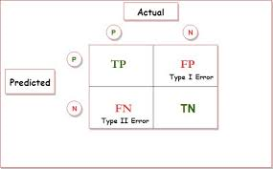
Multinomial NB Classifier :
Multinomial Naive Bayes Classifier is a specialized version of Naive Bayes Classier. This Classifier is suitable for classification with discrete features (such as word counts for text classification). The Multinomial distribution normally requires integer feature counts. The Multinomial NB Classier explicitly models word counts and adjusts the underlying calculations to deal with in.
ROC Curve-AUC Score :
The Receiver Operating Characteristic Curve, or ROC Curve, is a graphical plot that illustrates the diagnostic ability of a binary classier system. The Curve is plotted with TPR on the y-axis against FPR on the x-axis.
Area Under Curve Score or AUC Score represents degree or measure of separability. It is known that Higher the AUC Score, Better the model is at classifying or distinguishing. It provides an aggregate measure of performance across all possible classification models.
Confusion Matrix :
A Confusion Matrix, also known as Error Matrix, is a specific table layout that allows visualization of the performance of an algorithm or of a classification model(classifier) on a set of test dataset for which the true values are known.
It allows us to measure Accuracy, Recall, Precision, F1 score and Specificity. It gives the terms like True Positive, True Negative, False Positive and False Negative.

Slide 11
TP (TRUE POSITIVE) :
Labels which were predicted positive and were truly positive.
TN (TRUE NEGATIVE) :
Labels which were predicted negative and were truly negative.
FP (FALSE POSITIVE) :
Labels which were predicted positive but were truly negative, also known as type-1 error.
FN (FALSE NEGATIVE) :
Labels which were predicted negative but were truly positive), also known as type-2 error.
ACCURACY :
Measurement of being correct -- (TP+TN)/(TP+TN+FP+FN).
PRECISION :
Measurement of consistency, minimizing false positives -- TP/(TP+FP).
RECALL :
Measurement of completeness, also known as " TRUE POSITIVE RATE/SENSITIVITY", least false negative -- TP/(TP+FN).
F1 SCORE :
Indicates the balance between Precision and Recall -- (2*Precision*Recall)/ (Precision+ Recall).
SPECIFICITY :
Proportion of true negatives that are correctly predicted, also known as" TRUE NEGATIVE RATE“ -- TN/(TN+FP).

Slide 12
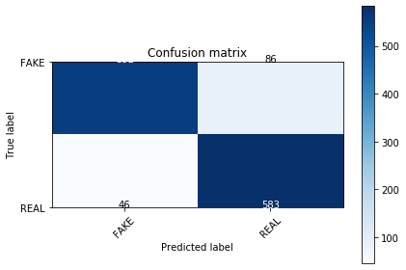

5. RESULTS I :
The Results that I have got after performing the experiment in Python is depicted here below. With the help of these results, it can be said that which classifier model performs best for detecting FAKE News.
CONFUSION MATRIXES FOR DIFFERENT MODELS :
Confusion Matrix For Multinomial
NB Classifier for CountVectorizer
Confusion Matrix For Multinomial NB Classifier for
TfidfVectorizer

Slide 13
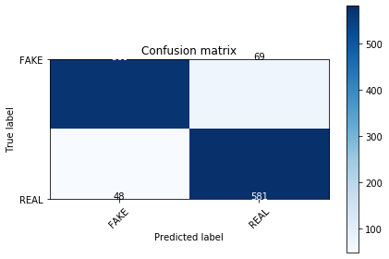
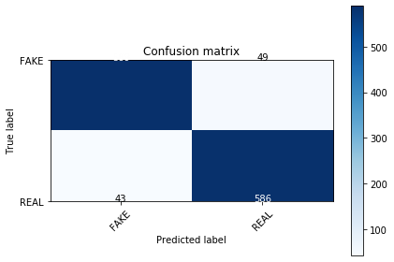
Confusion Matrix For PassiveAggressive Classifier for CountVectorizer
Confusion Matrix For PassiveAggressive Classifier for TfidfVectorizer

Slide 14
Summary Table :( TABLE FOR COMPARIOSN OF RESULTS FOR DIFFERENT MODELS)
CATEGORY | (MNB)COUNT | (MNB)TFIDF | (PA)COUNT | (PA)TFIDF
TRUE POSITIVE | 583 | 597 | 581 | 586
TRUE NEGATIVE | 552 | 549 | 569 | 589
FALSE POSITIVE | 86 | 89 | 69 | 49
FALSE NEGATIVE | 46 | 32 | 48 | 43
ACCURACY | 0.896 | 0.904 | 0.908 | 0.927
PRECISION | 0.8714 | 0.8703 | 0.8938 | 0.9269
RECALL | 0.9269 | 0.9491 | 0.9237 | 0.9316
F1 SCORE | 0.8983 | 0.9080 | 0.9085 | 0.9272
SPECIFICITY | 0.8652 | 0.8605 | 0.8918 | 0.9232

Slide 15
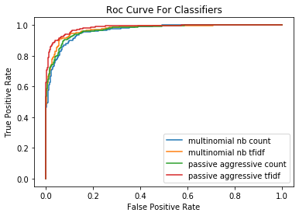
Remark :
From the result that I have got in the Python Experiment, it can be concluded that TfidfVectorizer under PassiveAggressive Classifier has performed better than all other models (the other 3 -- CountVectorizer and TfidfVectorizer under Multinomial Naive Bayes Classier and CountVectorizer under PassiveAggressive Classier) and has been marked bold in the above table. So, it can be concluded that for detecting fake news TfidfVectorizer under PassiveAggressive Classier is very good as a classier. The other 3 models have also performed very well, but TfidfVectorizer under PassiveAggressive Classier is the best among all.
ROC Curve-AUC Score :
The ROC Curve for all the fitted models have been drawn and from there We calculate the AUC Score.
multinomial nb count: ROC AUC =0.943
multinomial nb tfidf: ROC AUC =0.974
passive aggressive count: ROC AUC =0.965
passive aggressive tfidf: ROC AUC =0.984
From ROC Curve-AOC Score, it is also clear that
Tfidf Vectorizer under PassiveAggressive
Classifier has more area than any other has and it is
al most equal to 1. So, it can be said that
Tfidf Vectorizer under PassiveAggressive Classifier can
distinguish the Real and Fake news properly.

Slide 16
6. RESULTS II :
Top 10 FAKE and REAL News :
I have calculated Top 10 Fake and Real News from the dataset using TfidfVectorizer under PassiveAggressive Classifier.
'FAKE': [(-5.75262481957928, '2016'),(-5.013395767858511, ‘october'),(-3.3317257993521103, 'share'),(-3.1820089432261827, ‘november'),(-3.1797842442085833, ‘hillary'),(-3.166170786600595, 'election'),(-2.98624689630123, 'article'),(-2.7660263445195885, 'establishment'),(-2.622800113119332, 'source'),(-2.6008732183439367, 'advertisement')]
'REAL': [(2.2081239496198077, ‘tuesday'),(2.2393404470471086, 'march'),(2.3409065304458325, 'rush'),(2.5316800802138326,'candidates'),(2.774128444835958, 'friday'),(2.795466506249762, ‘gop'),(2.859657787244346, 'conservative'),(3.032373662107259,'marriage'),(3.2988305717585407, 'says'),(4.885489173724793, 'said’)]
The above is the list of words with Classifier Coefficient for top 10 FAKE and REAL News. So, we can say from now that when and where the words will occur, we can classify them as FAKE or REAL accordingly.

Slide 17
Most 20 REAL and FAKE News :
I have also calculated Most 20 Real and Fake News from the dataset using TfidfVectorizer under PassiveAggressive Classifier.
*** Most Real:
[(-4.425109600312677, 'said'),(-4.522246319612897, 'trump'),(-4.913489679506659, ‘clinton'),(-5.433999076102811,
'people'),(-5.43734250839567, 'state'),(-5.474468531540541, 'president'),(-5.518993714015171, ‘obama'),(-5.522634286821445,'new'),(-5.54871648515088, 'campaign'),(-5.6934753665840425, 'republican'),(5.790413196932821, 'party'),(-5.904344402407975,'time'),(-5.910333199226768, 'like'),(-5.927230878590333, 'states'),(-5.938548337550461, 'sanders'),(-5.938873583113727,'just'),(-6.0240501866528735, 'house'),(-6.045894498625599,
'percent'),(6.0649002240255605, 'political'),(-6.1210585238863136,’Cruz’)]
*** Most Fake:
[(-16.272226130581554, '000035'),(-16.272226130581554, '0001'),(-16.272226130581554, '0001pt'),(-16.272226130581554,'0002'),(-16.272226130581554, '000billion'),(-16.272226130581554,'0011’),(-
16.272226130581554,'004s'),(16.272226130581554,'005'),(-16.272226130581554,'005s'),(-16.272226130581554,'00684'),(-16.272226130581554,'006s'),(-16.272226130581554,'007'),(-16.272226130581554,'007s'),(-16.272226130581554,'008s'),(-16.272226130581554,'0099'),(-16.272226130581554,'00am'),(-16.272226130581554,'00p'),(-16.272226130581554,'00pm'),(-16.272226130581554,'013c2812c9'),(-16.272226130581554,'014’)]
The above is the list of words for most 20 REAL and FAKE News with Classifier Coefficient. So, we can say from now that when and where the words will occur, we can classify them as REAL or FAKE accordingly.

Slide 18
Aggregated REAL and FAKE Dataset :
I have also calculated Aggregated no. of occurring of words combining all the model classifiers in REAL and FAKE news and ordered them in ascending order.
TABLE FOR AGGREGATED RANK OF REAL WORDS
WORDS | LABEL | AGG RANK | COUNT
said | Real | 9.667 | 3
republican | Real | 1.5 | 2
rush | Real | 6.5 | 2
march | Real | 5 | 2
gop | Real | 6 | 2
friday | Real | 5 | 2
candidates | Real | 3.5 | 2
campaign | Real | 3.5 | 2
marriage | Real | 4.5 | 2
trump | Real | 9.5 | 2

Slide 19
TABLE FOR AGGREGATED RANK OF FAKE WORDS
WORDS | LABEL | AGG RANK | COUNT
000035 | Fake | 1 | 2
005s | Fake | 9 | 2
2016 | Fake | 4.5 | 2
share | Fake | 4 | 2
0001 | Fake | 2 | 2
article | Fake | 5 | 2
00684 | Fake | 10 | 2
october | Fake | 3 | 2
005 | Fake | 8 | 2
000billion | Fake | 5 | 2

Slide 20
7. CONCLUSION :
In this project, we explore different aspects of incorporating neural, statistical and external features to deep neural networks on the task of fake news stance detection. We also presented in-depth analysis of several state-of-the-art recurrent and convolution architectures. The presented idea leverages features extracted using count vectorizer and tfidf vectorizer under multinomial nb classifier and passiveaggressive classifier.
We found that Tfidf Vectorizer under PassiveAggressive Classifier performs the best in determining
Fake News and in classifying them as Real and Fake one. Though there is still scope for further improvement in the topic and hope to be explored in future.

